Slide 1
Food Prices in Developing Countries:
Who Wins, Who Loses, and What Can We Do?
Marc F. Bellemare
Sanford School of Public Policy – “Food for Thought” Faculty Discussion Series
February 2011

Slide 2
Framing the Issue
In the 30 years since the Food and Agriculture Organization (FAO) of the United Nations has been recording food prices, the food price index has never been this high (FAO, 2011).
In 2000, the food price index averaged 90. In 2010, it averaged 185.
The food price index currently stands at 231, i.e., above food price levels experienced during the food crisis of 2007-08.

Slide 3
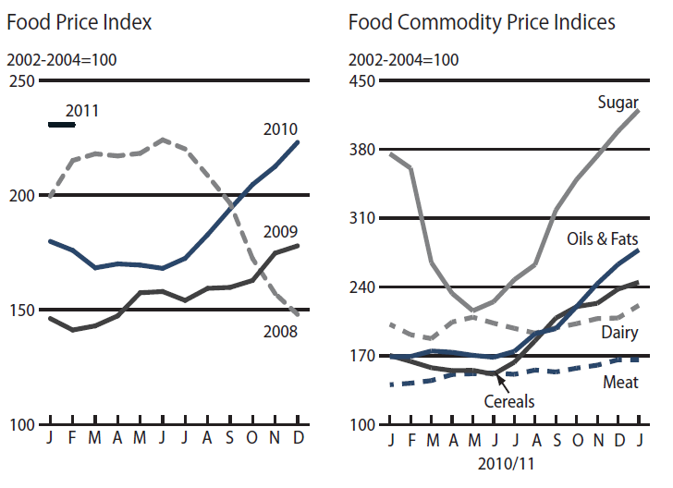
(Source: FAO Global Food Price Monitor, 3 February 2011.)

Slide 4
Framing the Issue
Likewise, food price volatility (i.e., unexpected departures from the food price level) has also been on the rise (FAO, 2010).
Much like natural disasters, episodes of extreme price volatility are rare, but there is always a certain amount of uncertainty over future prices.

Slide 5
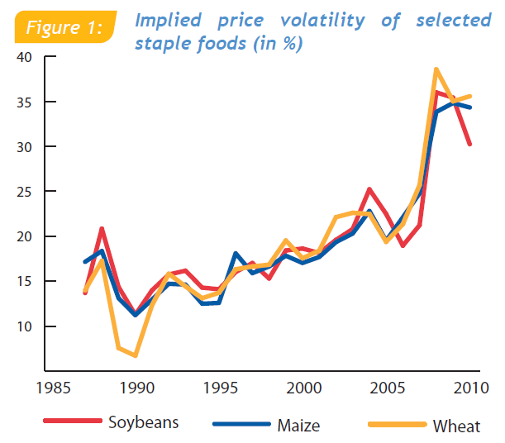
(Source: FAO Economic and Social Perspectives Policy Brief #12.)

Slide 6
Framing the Issue
But while economists have long understood the welfare impacts of rising food prices, the impacts of food price volatility (or price uncertainty, or price risk) on welfare are not understood all that well.
What we know from economic theory is that producers are price risk-averse and consumers are price risk-loving.

Slide 7
Framing the Issue
But often, the unit of analysis in development policy is the household, which can both produce and consume staple commodities.
Moreover, many people conflate the twin issues of rising food prices and food price volatility, and “price fluctuations” seem equally confusing to the general public.

Slide 8
Outline
Framing the Issue
Methodology
a) Rising Food Prices
b) Food Price Volatility
c) Data
Key Findings
Policy Implications
Other Relevant Research

Slide 9
Methodology: Rising Food Prices
We have known how to measure the impacts of rising food prices on household welfare since Deaton’s (1989) seminal article discussing the net benefit ratio (NBR).
For commodity i, the household’s NBR s_{i}(y,p) is such that
where p denotes price, q denotes quantities, b and s denote purchases and sales, and y denotes income.

Slide 10
Methodology: Rising Food Prices
It is easy to show that for an increase in the price of commodity i,
s_{i}(y,p) < 0 if the household is a net buyer of
s_{i}(y,p) = 0 if the household is autarkic with respect to, and
s_{i}(y,p) > 0 if the household is a net seller
of commodity i.
The NBR is easy obtain – one does not even need to run a regression. It can be computed from the relevant data.

Slide 11
Methodology: Food Price Volatility
What economists did not know until very recently was how to measure the welfare impacts of food price volatility (also known as price risk, or price uncertainty).
In Bellemare et al. (2011), we develop a measure of household willingness to pay (WTP) to stabilize (i.e., eliminate the volatility in) the price of several commodities at once.

Slide 12
Methodology: Food Price Volatility
To stabilize the price of commodity i, the household’s WTP is such that
where σ_{i} is the variance in the price of commodity i and σ_{ij} is the covariance between the price of commodity i and the price of commodity j.
The A coefficients are the household’s coefficients of price risk aversion – those need to be estimated using regression results, as they rely on elasticities and budget shares.

Slide 13
Methodology: Food Price Volatility
Likewise, to stabilize the price of all commodities, the household’s WTP is such that
One can thus estimate household WTP to stabilize the price of one commodity or household WTP to stabilize the prices of a number of commodities.

Slide 14
Methodology: Food Price Volatility
Because households both produce and consume, the sign of their WTP to stabilize prices is not immediately obvious.
While it is generally the case that a net producer of a commodity will be price risk-averse (i.e., WTP_{i} > 0) and that a net consumer of the same commodity will be price risk-loving (i.e., WTP_{i} < 0) with respect to the price of that commodity, the relationship is not one-to-one given the relative magnitudes of the coefficients involved in computing these WTPs.

Slide 15
Methodology: Data
The data used in this exercise come from the publicly available Ethiopia Rural Household Survey (ERHS)
I use the 1994a, 1994b, 1995, and 1997 rounds of the ERHS, which records both household consumption and production decisions for a number of commodities.
The data include 1494 rural households across 16 districts and over three seasons. The results I am presenting today rely on 8556 observations.

Slide 16
Methodology: Data
In what follows, I will focus on the top seven commodities (percentage of non-autarkic households in parentheses):
Coffee (79%)
Maize (46%)
Beans (35%)
Wheat (33%)
Teff (33%)
Sorghum (31%)
Barley (20%)

Slide 17
Methodology: Data
The proportions of households who neither buy nor sell of each commodity are quite high in these data.
These households are insulated from the market – rising food prices and food price volatility have no effect on their welfare, but they have lower welfare overall.
This can be the result of preferences – a household may not like teff, and so it neither buys or sells it. Often, however, it is the result of transaction costs, which make it too costly for the household to participate on the market as a buyer or a seller (Bellemare and Barrett, 2006).

Slide 18
Methodology: Data
This problem of market access is a significant aspect of my research agenda.
We often hear policy makers talk about increasing agricultural productivity in sub-Saharan Africa, but what would increased productivity bring without market access?
Asked about a potential Green Revolution in Africa, Norman Borlaug once famously said that in Asia, “we just didn’t have to worry about the market (...). All we had to worry about was the science.”

Slide 19
Key Findings
There is no need to compute NBRs to know that rising food prices benefit net sellers but hurt net buyers in the data.
On average, the households in the data are price risk averse. That is, they are hurt by food price volatility.
The average household would be willing to give up to 19 percent of its income to stabilize the prices of the seven commodities retained for analysis, but this masks a surprising amount of heterogeneity.

Slide 20
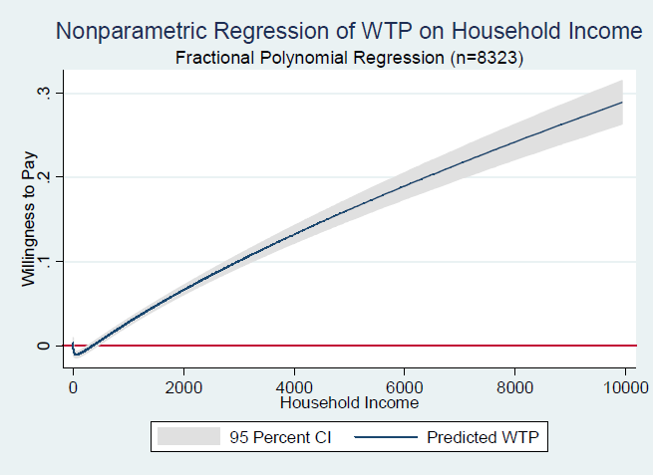

Slide 21
Key Findings
In other words, the average masks the fact that the very poor in these data actually benefit slightly from food price volatility.
That is, the main result is driven by the fact that wealthier households, who are hurt by food price volatility, lose out more than the poor benefit from food price volatility.

Slide 22
Key Findings
Having established the welfare impacts of food price volatility, what happens when we look at the combined impacts of rising food prices and food price volatility?
Again, the results are interesting and go against much of the policy discourse and media narratives surrounding rising food prices and food price volatility.

Slide 24
Key Findings
On the one hand, the households who benefit from rising food prices (i.e., those in the right-hand side of the graph) are hurt by food price volatility (i.e., their WTP for price stabilization is positive).
On the other hand, the households who are hurt by rising food prices (i.e., those on the left-hand side of the graph) benefit from food price volatility (i.e., their WTP for price stabilization is negative).

Slide 25
Key Findings
So when Nicolas Sarkozy claims that has decided to make food price volatility the centerpiece of his tenure as head of the G20 (Reuters 2011), it is not clear whether he really means to tackle food price volatility.
Indeed, doing so would mean hurting the poorest of the world’s poor.
Rather, it looks as though Sarkozy meant rising food prices.

Slide 26
Policy Implications
This is where my expertise is about as good as most people’s.
The only thing I can assert with confidence is that a policy that would hold prices constant, would simultaneously hurt and benefit both poor and wealthier households.
Indeed, holding prices constant means that food price volatility is eliminated, and it means that food prices no longer rise.

Slide 28
Policy Implications
A few observations:
It is not obvious what the relative welfare impacts of such a policy would be.
It is also not obvious that this would not introduce significant distortions on the market, making such a policy second-best to laissez-faire.
Such a policy would undoubtedly be (administratively) very costly, as it would involve governments buying, holding, and selling commodities in the right amounts.

Slide 29
Policy Implications
How about commodity exchanges, where speculators could trade food futures in order to arbitrage?
This would presumably smooth out prices over time and reduce food price volatility.
Although some people believe that speculation has led to the current food crisis, Paul Krugman noted last week that we are just not seeing signs of speculation on food markets.

Slide 30
Other Relevant Research
Over the past five years, I have also worked on these related topics:
The determinants of market participation.
The welfare impacts of smallholder participation in agricultural value chains.
The impacts of insecure land rights on agricultural productivity and agrarian contracts.
The determinants of agricultural productivity.

Slide 31
Other Relevant Research
I am also working on the concept of micro-insurance. Along with coauthors Michael Carter and Catherine Guirkinger, I am preparing a randomized control trial aimed at evaluating index insurance for cotton producer groups in Mali.
I also blog regularly on issues related to food prices, but also development policy in general as well as issues related to law economics at http://marcfbellemare.com.

